Slide 1
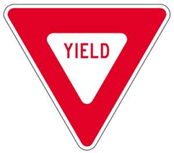
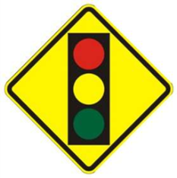
Signs Test

Slide 2
Colors of signs Define the color
1.
2
3
4
5
6.
7.
8.
9.

Slide 3
Identify the Sign
1.
2.
3.
4.
5.
6.
7.
8.
9.
10.

Slide 4
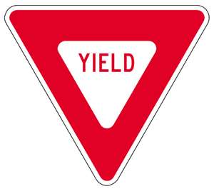
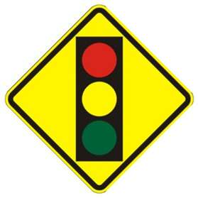
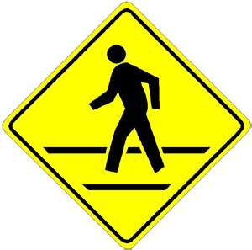
Identify the sign
11.
12.
13.
14.
15.
16.
17.
18.

Slide 5
Colors Answers
1.Red – Regulatory signs
2.Blue – Guide signs Services along roadway
3.Yellow- Warning signs road conditions and dangers ahead
4.White/black- Regulatory signs
5.Orange – warning signs Construction or maintenance
6.Green- Guide signs Which way to go and distance
7.Brown-Parks and recreation
8.Pink-Traffic incident signing. Crash or natural disaster
9.Yellow-green- Warning signs for school/pedestrian crossing.

Slide 6
GO CUBS

Slide 7
Signs answers
1.Reduction in lanes
2.Divided highway
3.No u turn
4.Construction zone
5.No passing zone
6.Do not enter
7.Merging
8.Side road
9.Crossroad
10.school zone crossing
11.Yield
12.Signal ahead
13.Stop
14.No right turn
15. Slow moving vehicle
16. Winding road ahead
17.Railroad crossing
18.Pedestrian crossing

