Slide 1
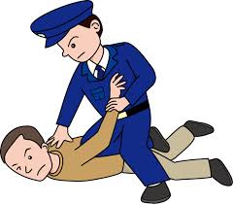
Rules of the Road
Chapters 1-5

Slide 2
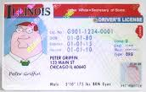
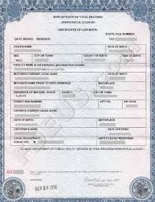
Chapter 1
Document/Identification requirements
You need to prove legal name, date of birth, Social security number, residency and signature.
First-time applicants for drivers license
1 Written signature. Ex- Credit card, State ID, SS card
1 Date of birth. Ex- Birth certificate, State ID
1 Social security number. Ex-SS Card
2 Residency- Ex- report card, utility bill
One document may satisfy more than one group

Slide 3
Chapter 1 Cont
Class D license
Non Driving programs
Ask if you want to be organ tissue donor
Voter registration
Selective service
Page 10 give all the fees for license

Slide 4
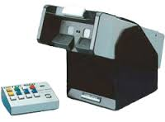
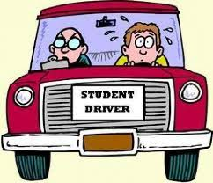
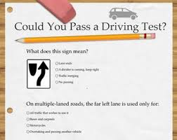
Chapter 2
Three exams you have to pass
Vision exam
Written exam
Driving exam

Slide 5
Chapter 3
Obtaining Permit
Between ages 15-17
Enrolled in approved driver ed course
Permit is good for 24 months
Have to have 9 months before get license
Drive with adult over 21
50 hours BTW 10 night plus hours with instructor
Get A or B in class and driving = wavier

Slide 6
Chapter 3 Graduated Driver licensing Program (GDL)
Permit Phase (age 15)
Initial licensing Phase (age 16 – 17)
Full Licensing Phase (18-20)
Applying for your license
Need permit, Forms of ID talked earlier, Consent for minor (under 18), 50 hour sheet, Completion of driving and classroom.

Slide 7
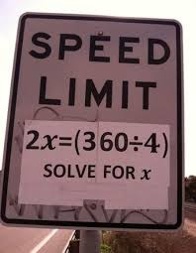
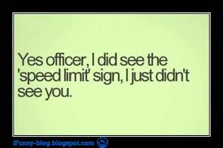
Chapter 4
Safety belt law
Where ever you sit wear seat belt
Put children in back seat In approved seat. (8 under)
Speed limits
Freeways tollways 55-65mph
City towns 30mph
Alleys 15mph
School zones 20mph 7am-4pm on school days (no cell phones)
Construction zones Obey posted signs

Slide 8
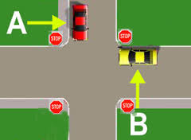
Chapter 4
Funeral procession
Right of way
Always yield to your right
Must be giving never assumed
Passing
Pass on left
No Passing (curves, hill, tunnels, soild lines)

Slide 9
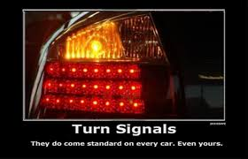
Chapter 4
Signaling
Signal 100 feet before turn
To inform others of your intentions
Special Stops
School bus
Stop when stop sign out flashing lights (two way high)
Don’t have to stop four or more lane highway or if traveling in opposite direction . (always drive cautiously)
Railroad
Stop 15 to 50 feet away when lights flashing
-- Alleys/driveways
- come to complete stop before entering sidewalk

Slide 10
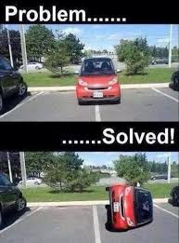
Chapter 4
Parking
Perpendicular, Parallel, Angle
Up hill (away curb) Down Hill (toward curb)
No parking
Within 15 feet from fire hydrant
Within 20 feet firestation driveway, crosswalk intersection
Within 30 feet from stop, yield, and traffic signals.
Within 50 feet from raildroad

Slide 11
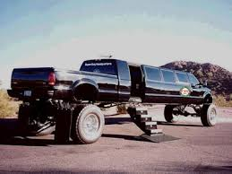
Chapter 5
Large Vehicles
Line of sight
You cant see mirrors they cant see you
Longer stopping distances
Motorcycles
Have same right to whole lane as car.
Bicycles
Most roadways have same right as cars
Be cautious around

