Slide 1
Rules of the road
Chapters 6-13

Slide 2
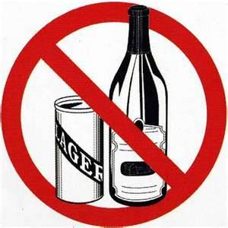
Chapter 6
Blood Alcohol Concentration (BAC)
.08
Your (BAC) can be affected by
Body weight or size
Food you have eaten
Tolerance of alcohol
The amount you drink
12oz beer 5oz of wine and 1.5 oz hard liquor
Contain same amount of alcohol
Time is the only way to remove alcohol from body.

Slide 3
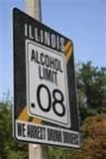
Chapter 6
Drivers under age 21
License is printed Vertically
Dui Under 21 = lost of driving privileges for 2 years first time conviction
Alcohol Is the greatest factor in fatal motor vehicle accidents.

Slide 4
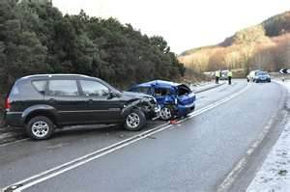
Chapter 7
Traffic violations and crashes
Stop vehicle in well lighted area.
Help any injured person
Call 911
Ask all people involved
Name, address, phone #, Driver license, and License plate #.
Unattended vehicles
Yielding to Emergency
vehicles

Slide 5
Chapter 8
Revocation
The indefinite withdrawal of driving Privileges.
Aggravated DUI- personal injury or death of DUI
Aggravated Fleeing police
Aggravated reckless driving
Auto theft
Drag racing
Gang related activity
Leaving the scene
Reckless homicide

Slide 6
Chapter 8
Suspension
Temporary loss of driving privileges
Traffic violations
Crash in construction zone
Drug alcohol test failed
Failure to obey railroad crossing signal
Failure to yield to emergency vehicle
Fake ID
Illegal transportation of alcohol
No insurance
Tollway violations
Traffic crash

Slide 7
Chapter 8
Cancellation
The annulment or termination of license because of some error or defect.
Medical condition
Re-examination requirement
Fraudulent Application
Ineligle

Slide 8
Chapter 8
Denial
Temporary denial of the privilege of applying for license.
Driving without valid license or permit
Serious moving violations
Crash involving bodily harm or death

Slide 9
Chapter 8
Special Driving Permits
Illinois drivers whose privileges have been revoked or suspended.
Restricted Driving Permit
Monitoring Device Driving Permit
Occupational Driving Permit
Family Financial Responsibility driving permit

Slide 10
Chapter 10
Traffic signals
Red light = Stop
Yellow light = Warning a change from green to red
Green light = May go after yielding right of way
Stale green light = Light that has been green for a while
When do you go on a green light?
Flashing Lights
Red = Stop and yield the right of way
Yellow = Proceed with caution

Slide 11
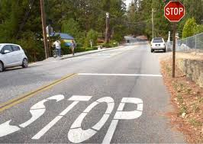
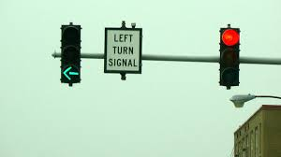
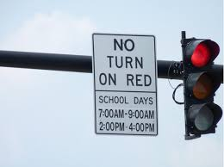
Chapters 10
Stop sign
Full stop behind white bar, crosswalk or sign
Feel car kick back = Full stop
Arrows
Red= Cant turn till it turns green
Yellow= The green arrow is ending
Green= You may make your turn
Red light but green arrow when can
you make the turn?
Can you make turns on red?

Slide 12
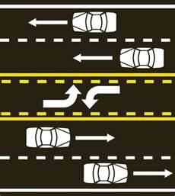
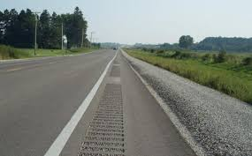
Chapter 10
Pavement Markings
White lane lines
Traffic in same direction
Broken you can cross
Solid single crossing discouraged
Double solid line crossing prohibited
Yellow center lanes
Traffic in opposite directions
Broken lines you may pass
Solid line you cannot pass
Shoulder of the road
What is it and can you pass using it.

Slide 13
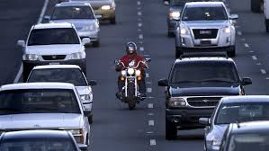
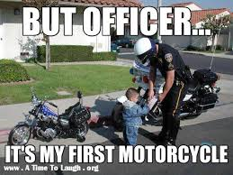
Chapter 10
Motorcycles
Even though small have same right away privileges as cars.
Have use of full lane
Can not drive on the lane lines to pass other vehicles

Slide 14
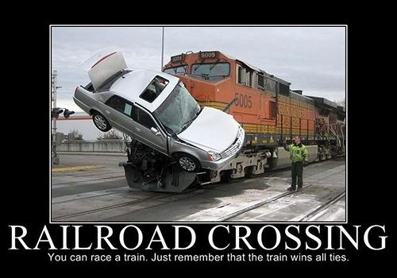
Chapter 10
Railroad crossing
Stop within 15-50 feet
Look for flashing lights
Look for crossing gates
Railroad safety laws
Drive through expecting a train
Once train pass look for another
Make sure you can get all the way across tracks.
When should you cross tracks after train clears?
What should you do if there is no flashing light or gate?

Slide 15
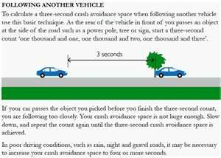
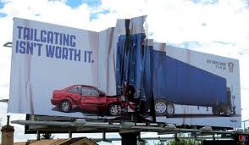
Chapter 11
Defensive driving
Always be prepared to react to other vehicles
Don’t assume others know what they are doing
Expect the unexpected
Following distance
3 second rule good conditions
5-7 seconds poor conditions
What is cause of most rear end
collisions?

Slide 16
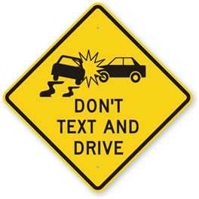
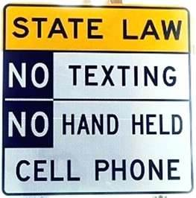
Chapter 11
Distracted driving
Greatest hazards to the road way
No Texting while driving anytime
No use of cellphones if under 18
Use speakerphone or Bluetooth if possible
Never in construction or school zone

Slide 17
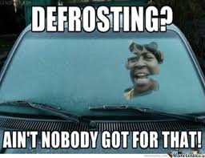
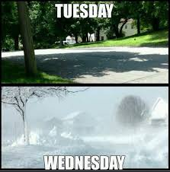
Chapter 11
Weather conditions
Fog
Always use low beam lights
Rain
Night
High winds
Winter driving
Following distance 5-7 seconds
Bridges freeze before streets
Lights are required
Take special care going around curves
Stop gradually ( don’t slam on brakes)

Slide 18
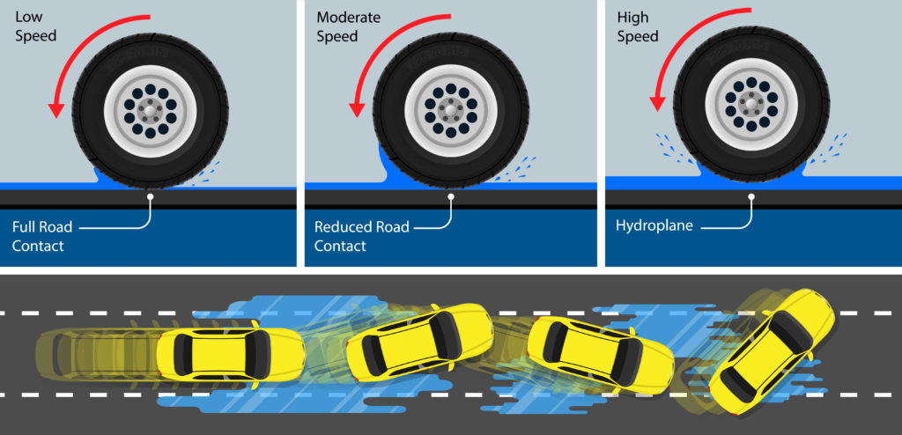
Chapter 11
Hydroplaning
slide uncontrollably on the wet surface of a road.
Caused by a combination of standing water on the road, car speed, and under-inflated or worn-out tires.

Slide 19
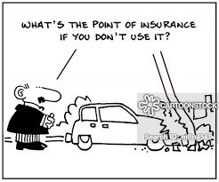
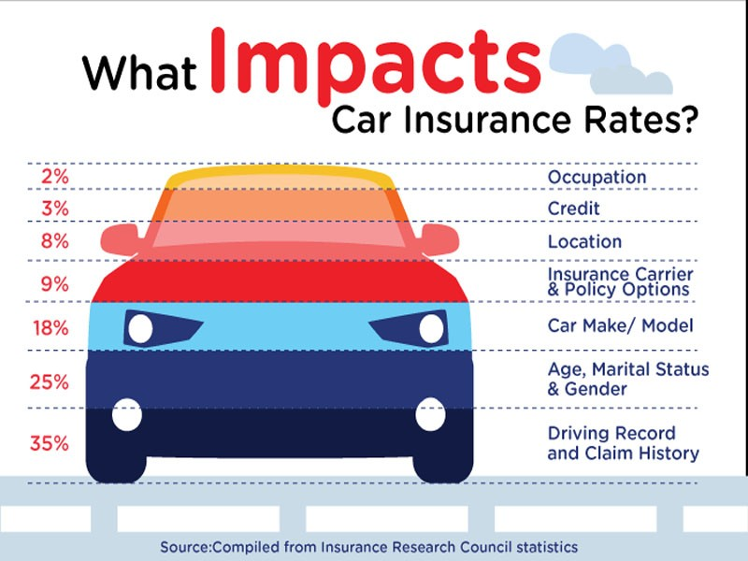
Chapter 13
Insurance
Must have insurance to drive.
Males under 25 most expensive
Two types
Comprehensive –
Cover you and vehicle you hit
More expensive
Liabilty
Covers the car you hit
Not as expensive

