Slide 1
Negotiating Intersections
Chapter 10

Slide 2
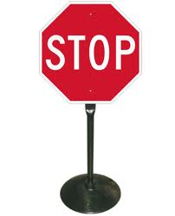
Intersections
Tips for Identifying an Intersection
Street lights and signs.
Roadway markings, such as a stop sign or signal.
Stopping or turning traffic.
Pedestrians
Rows of fences and mailboxes.
Power lines crossing over street.

Slide 3
Searching Intersections
Approaching an Intersection
12-15 seconds away
Check for signs and signals
solve any path of travel or line of sight restrictions.
4-6 seconds away
Widen your search to the left and right.
Identify any potential hazards.
2 seconds away
Reached point of no return.

Slide 4
Determining Right of way and judging gaps
Right of Way
Your action should not cause others that you should of yielded to, to slow, stop, or change path of travel.
Traffic signs only show who should yield the right of way. They don’t stop traffic.
Yield always to your right.
Don’t assume others will always yield to you.
Sometimes it is better to yield even when the other vehicle is supposed to.

Slide 5
Determining Right of way and Judging Gaps
Judging Gaps
Gap - is the distance between to vehicle.
The size of the gap you need depends on the maneuver that you plan on making.
Joining traffic
Making a right turn and speeding up to 30mph takes about 6 seconds.
Making right turns are safer
than crossing traffic .

Slide 6
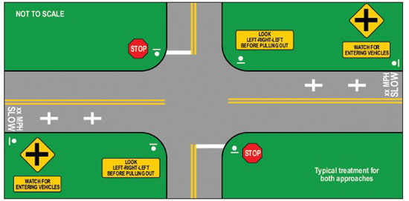

Slide 7
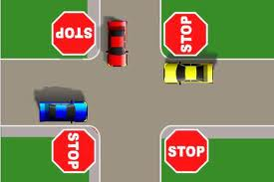
Controlled intersection
A controlled intersection is one that has traffic signs or traffic signals to determine right of way.
Controlled intersection signs
Yield, stop, slow.

Slide 8
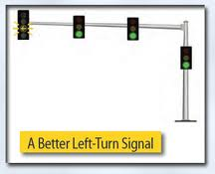
Controlled Intersection (Cont)
Controlled intersection signals
Fresh green light
Stale green light
Delayed green light
Yellow light
Red light
Unprotected left turns
Protected left turns

Slide 9
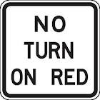
Controlled Intersection
Turning on red
Make complete stop at the intersection
Check for signs, pedestrians, Bikes, and other vehicles.
Once all clear than you can make right turn.
You can only make a left turn on red when turning onto a one way street.

Slide 10
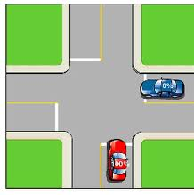
Uncontrolled Intersections
An Uncontrolled intersection has no sign or signals to regulate traffic.
Most uncontrolled intersections are located in residential areas where there is light traffic.
These intersections are very dangerous because not all people look as they pass through these intersections.

Slide 11
Uncontrolled Intersections
Approaching an uncontrolled intersection.
Identify the intersection
As you approach intersection let off accelerator and cover brake.
Before entering the intersection look left and than right to check for traffic.
Stop if there is traffic
If clear move foot back to accelerator and go through intersection.

Slide 12
Uncontrolled Intersections (Cont)
Identifying restrictions in uncontrolled intersections.
Parked cars on the street.
Bushes or trees block signs.

Slide 13
Railroad crossings
Active Railroad crossing.
Crossing that has electric signals.
Cross buck
Red flashing lights
Bells rings
Passive railroad crossing.
These crossing have no electric warning signs.
Usually in rural and low populated areas.

Slide 14
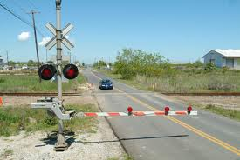
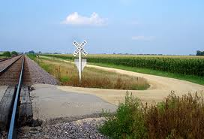
Active and Passive railroad

Slide 15
Railroad Crossing
Precautions crossing intersections.
Slow be ready to stop.
Look both ways before crossing.
Listen for train noises.
Stop 15 feet before railroad tracks.
Wait for train to pass than look both ways before crossing.
Drive across railroad tracks only when there is enough space to clear tracks.

Slide 16
Review Questions
Define
Intersection, Right of way, gap, joining traffic, roundabout
Describe a situation that a driver must yield the right of way?
How does an unprotected left turn differ from a protected left turn?
What’s the difference between uncontrolled and controlled intersections? Why are uncontrolled intersections more dangerous?

