Slide 1
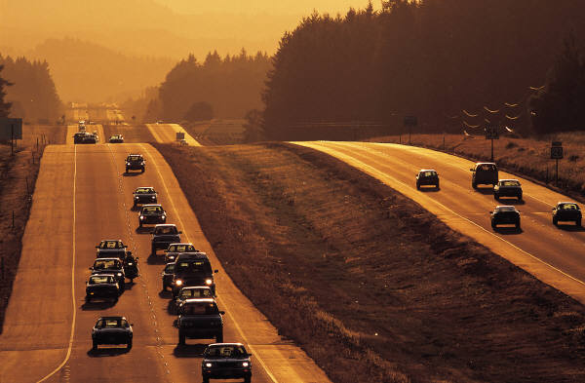
IPDE Process Chapter 5

Slide 2
IPDE Process
Need an organized system of seeing thinking and responding.
Better equipped to manage risk
Reduce possibility of damage or harm

Slide 3
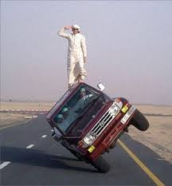
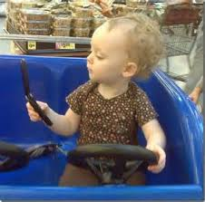
Risk
All activities
Driving = high degree of risk
Contributing factors
Driver
Vehicle
Roadway
Environment

Slide 4
Teen risk Statistics
In 2013, 2,163 teens in the United States ages 16–19 were killed and 243,243 were treated in emergency departments for injuries suffered in motor vehicle crashes.
That means that six teens ages 16–19 died every day from motor vehicle injuries.

Slide 5
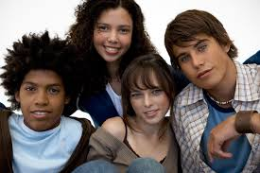
Who is most at risk
Males: In 2013, the motor vehicle death rate for male drivers and passengers ages 16 to 19 was almost two times that of their female counterparts.¹
Teens driving with teen passengers: The presence of teen passengers increases the crash risk of unsupervised teen drivers. This risk increases with the number of teen passengers.^{4,5}
Newly licensed teens: Crash risk is particularly high during the first months of licensure.^{6,7}

Slide 6
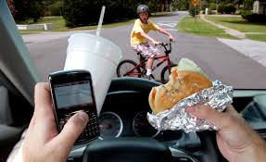
Driver-contributed factors
Adjusting radio
Being angry
Having blurred vision
Combing hair
Drinking while driving
Using cell phone
Notes:
Apply to other drivers on roadway
They can increase or decrease your level of risk and chance of conflict

Slide 7
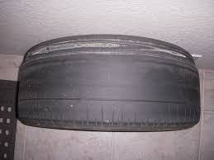
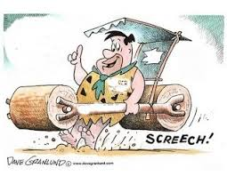
Vehicle-contributed factors
Bald tires
Poorly adjusted brakes
Dirty windshield
Broken headlights
Worn wiper blades
Notes:
Owner’s responsibility

Slide 8
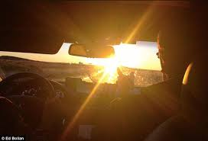
Roadway and environment-contributed factors
Bright sun
Construction
Dark shadows
Snow and ice
Sharp curve

Slide 9
Managing Risk
Make sure nothing about your own condition or the condition of the vehicle raise your level of risk.
Good drivers make every effort to manage risk in order to lower probability of conflict.

Slide 10
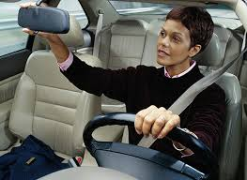
Managing Risk
Develop low-risk driving behaviors now, as these will become your safe driving habits later.
Notes:
A driver is likely to get into trouble when multiple risk factors accumulate at one time.
Having good driving habits can help to eliminate or compensate for those unknown risk factors.
Developing the habit of using the IPDE process can give you timely information to protect against unknown risk

Slide 11
The IPDE Process
IPDE Process,
Smith System and
Zone Control System
can enable you to enjoy low-risk and low-stress driving.
Safe driving depends upon your ability to see and analyze traffic situations correctly.

Slide 12
IPDE Process
DEFINITION:
Organized system of seeing, thinking and responding
4 steps
Identify
Predict
Decide
Execute

Slide 13
Identify
Use visual search pattern to identify
Open and closed zones
Specific clues
Other users
Roadway features and conditions
Traffic controls

Slide 14
Predict
Use knowledge, judgment, and experience
Actions of other users
Speed
Direction
Control

Slide 15
Decide
Decide to use one or more actions to
Change or maintain speed
Change direction
Communicate

Slide 16
Execute
Execute your decisions to
Control speed
Steer
Communicate
Combine actions
Notes:
1st “read” traffic situation and gather info for your decision and action.
Identify hazards and predict conflict.
Decide how to avoid and then execute correct action

Slide 17
Zone Control System
DEFINITION:
Organized method for managing 6 zones of space surrounding your vehicle
Allows you to see and respond to changes in traffic environment

Slide 18
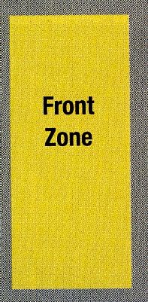
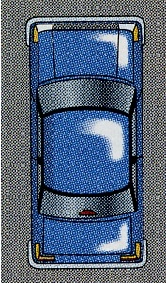
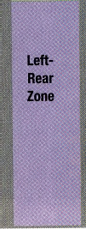
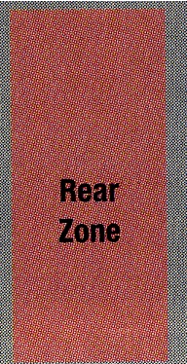

Slide 19
Zones and Searching Ranges
OPEN ZONE—space where you can drive without a restriction to your line of sight or intended path of travel.
LINE OF SIGHT—distance you can see ahead in the direction you are looking

Slide 20
Zones and Searching Ranges
CLOSED ZONE—is a space not open to you because of a restriction in your line of sight or intended path of travel
Red light
Parked vehicle to right
Vehicle following to closely
Sooner identify better chance to respond
Notes:
Page 66, picture

Slide 21
Zones and Searching Ranges
PATH OF TRAVEL—space your vehicle will occupy
TARGET AREA—section of the roadway where the target is located in the center of your intended path, and the area to the right and left.

Slide 22
Zones and Searching Ranges
TARGET AREA RANGE
1st searching range
Space from vehicle to the target area
Detect early any conditions that might affect intended path of travel

Slide 23
Zones and Searching Ranges
12-15 SECOND RANGE—
Space you will travel in during the next 12- 15 seconds
Identify changes in your line of sight or path of travel to make decisions about controlling your intended path

Slide 24
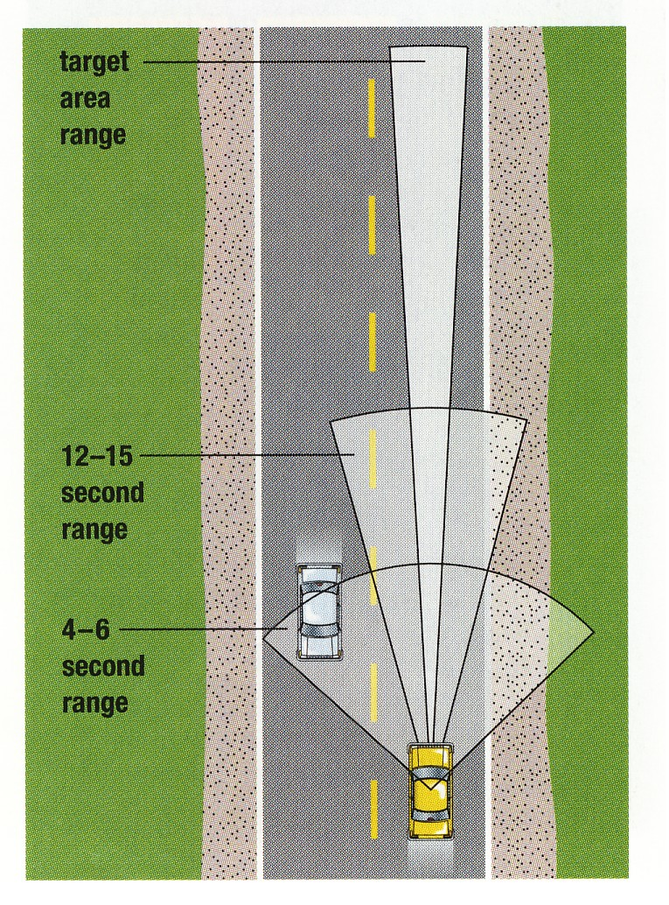
Zones and Searching Ranges
4-6 SECOND RANGE
Space you will travel in the next 4-6 seconds
Final update of how you are controlling your intended path of travel

Slide 25
Where and How to Look
FIELD OF VISION—area you can see around you, while looking straight ahead
CENTRAL VISION—area you can see clearly and sharply
10 degrees
PERIPHERAL VISION—area to the left and right of central vision
Notes:
Each situation is different as you gain experience you will learn what clues and situations are most important to identify to keep an open zone

Slide 26
Smith System
Aim high in steering
Keep your eyes moving
Get the big picture
Make sure others see you
Leave yourself an “out”

Slide 27
Aim High in Steering
12-15 seconds ahead
Far ahead to identify clues and analyze situations before zone becomes closed
What are some restriction to your line of sight that can cause a closed zone?
(pg 68)

Slide 28
Keep Your Eyes Moving
Look near, far, right, left, in mirrors
Fixate on object or event for an instant in order to identify it.
SCANNING—glancing continually and quickly with very brief fixations through your orderly visual search pattern

Slide 29
Get the Big Picture
Mental process of putting together the critical clues you have selected.

Slide 30
Selective Seeing
Identify and select clues and events that restrict your line of sight or change your intended path of travel

Slide 31
What to Look For
Other roadway users
Movement of other users, pedestrians, and bicyclists
GROUND VIEWING -- quick glances to roadway in front of your vehicle
Where front wheel heading
Problem drivers

Slide 32
What to Look For
Roadway features and conditions
Intersections, hills, curves
Lane reduction
Road construction
Width of lane
Road surface
Roadside hazards
Traffic Controls
Notes:
Lane reduction—identify signs early, expect open to close zone, check what zones? Left-front, right-front, and rear zones, don’t wait to get over
Width of lane—standing water, patches of snow, potholes, check which zone? Rear (for stopping), left-rear, and left-front (to move around)
Surface—changes in weather
Hazards—bicyclists, peds, parked vehicles, and animals. Shopping center entrances, exits, roadside stands, and restaurants.

Slide 33
What to do with info
Interpret the information you have identified.
Faced with more than one hazard/conflict = more complex predicting
Improve with knowledge and experience

Slide 34
What to do with info
Use knowledge, judgment, and experience
Knowledge = laws, experience
Judgment = measuring, comparing, and evaluating
Experience = improve ability to predict
Notes:
Knowledge – laws, experience
Judgment – judge: speed, time, distance, space, traction and visibility
Experience – exposure to variety of situations = solid base for making sound judgements

Slide 35
What to predict
Actions of other roadway users
Path
Action
Space
Point of conflict
Notes:
Are related to predicting changes in zones and looking for a way “out” or alternate path of travel
Path—where might he go?, What zone might be closed, Will I have an “out”
Action—What will others do? Is more than one action possible? Where will I be then?
Space– will I have an open zone/
Point of conflict—where might our paths cross and a conflict occure?
Driver on page 73

Slide 36
What to predict
Control of your vehicle and possible consequences
Speed
TRACTION—requirement for control
Gripping power between tires and surface of road

Slide 37
Decide
Change or maintain speed
Decelerate, brake, or accelerate

Slide 38
Decide
Change direction
Move right or left
Space cushion
Area of space all around your vehicle

Slide 39
Lane Positions
Lane position 1
Centered
Lane position 2
3 to 6 inches from left line
Lane position 3
3-6 inches from right line
Notes:
Lane 1 = safest, most space around vehicle
Position 2 = closed right-front zone, open left-front zone
Position 3 = closed left-zone with an open right-front zone
12 seconds ahead of search area

Slide 40
Decide
Communicate
Lights: head, tail, and brake
Turn signals
Parking lights and hazards
Horn
Car position
Eye contact
Notes:
Sending and receiving messages to and from
Smith System rule “make sure others see you”

Slide 41
Traffic flow
Safest position = fewest cars surround you
Manage time, space, and distance

Slide 42
Safe path of travel
Minimize hazard
Put more distance between yourself and the hazard
Separate hazard
Adjust speed to deal with one at a time
Compromise space
Give as much space possible to greater hazard
Notes:
Minimize pg 78 picture
Separate- if more than one hazard at one time
pg 78 picture
Compromise space– if can’t be minimized or separated
pg 79 picture

Slide 43
Execute
Physical skills used in driving
Most important actions:
Control speed
Steer
Communicate

Slide 44
Control speed
Check rear zone before decelerating
Be careful not to lock breaks
Impossible to steer
ABS system

Slide 45
Steer
Use just the amount of steering needed
Keep space cushions

Slide 46
Communicate
Using:
Headlights, taillights, and brake lights
Turn-signals
3-5 seconds before
Parking lights and hazards
Back-up lights
Horn
Vehicle position
Eye contact and body movement
Notes:
Communicate as early as possible
Headlights = greater visibility
Parking lights = no emergency, hazards = disabled, watch for hazards on other cars
Horn= light tap warning, loud blast emergency
Vehicle position – intended path of travel
Often times you will need to execute a combination of actions
Pg 82 picture

Slide 47
It is up to every driver to manage space, time and speed in order to further increase safety within the HTS.

Slide 48
Commentary Driving
System of thinking out loud as you practice the IPDE Process
Verbalize what you identify, predict and decide

Slide 50
Selective use of the IPDE Process
Conditions change and you need to begin a new cycle before completing one

Slide 51
Factors that can cause the IPDE process to take more time
Complex traffic situations
Feelings of driver
Physical condition of driver

Slide 52
Review Questions
What does IPDE stand for and give example of each step?
Define
Field of vison Space cusion
Line of sight Target area
Open zone Scanning

