Slide 1
BASIC VEHICLE CONTROL
CHAPTER 3

Slide 2
Basic Vehicle Control
When you begin driving, you will need to know the instruments, controls, and devices that you will use when driving.
The instrument panel is the panel directly in front of you as you sit in the driver’s seat.
Location of the gauges and warning lights varies from one vehicle to another

Slide 3
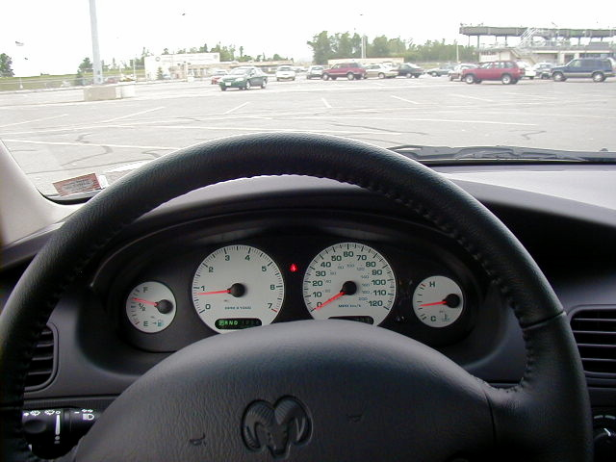
Instrument Panel
Speedometer
It tells you the speed you are traveling in both mph and km.
Tachometer
It indicates the engine revolutions per minute.
Odometer
Indicates the total number of miles the vehicle has been driven. Some have trip odometers.

Slide 4
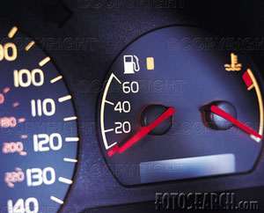
Instrument Panel
Fuel Gauge
Shows the amount of fuel in the tank. *Try to keep at least half full in cold weather.*
Temperature Light
Warns you when the coolant in the engine is too hot.

Slide 5
Instrument Panel
Oil Pressure Light
Warns you when the oil is not circulating at the proper pressure. *Check oil level now and then.
Alternator Warning Light
Warns that the battery is being drained, the alternator is not generating enough electricity to run the vehicle.

Slide 6
Instrument Panel
Brake System Warning Light
Warns you to release parking brake.
If your foot is on the brake and the light comes on, part or all of your braking system is not working properly.

Slide 7
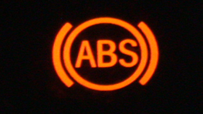
Instrument Panel
Anti-Lock Braking System Light
Tells you if your anti-lock braking system is working properly.
ABS keeps the wheels from locking (allowing you to steer) if you brake hard.

Slide 8
Instrument Panel
Safety Belt Light
Reminds you to fasten your seat belt.
Air Bag Warning Light
Tells you if your air bags are working properly.

Slide 9
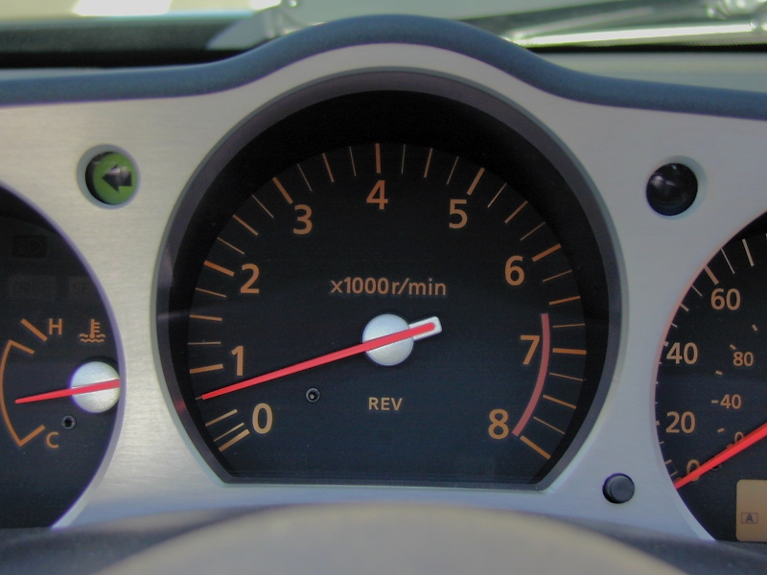
Instrument Panel
Turn-Signal Indicator
Tells you the direction you have signaled to turn. Use them when you are turning, change lanes or entering or exiting a parking space
It’s The Law

Slide 10
Instrument Panel
High Beam Indicator
Tells you if your high beams are on.

Slide 11
Vehicle Controls
Vehicle controls characteristics and locations vary from one vehicle to another. However, each control does the same thing in each vehicle.

Slide 12
Vehicle Controls
1. STEERING WHEEL
2. ACCELERATOR PEDAL
3. HAND BRAKE LEVER
4. FOOT BRAKE PEDAL
5. CLUTCH PEDAL
6. GEAR LEVER
7. INDICATOR LEVER
8. REAR VIEW MIRROR
9. SPEEDOMETER

Slide 13
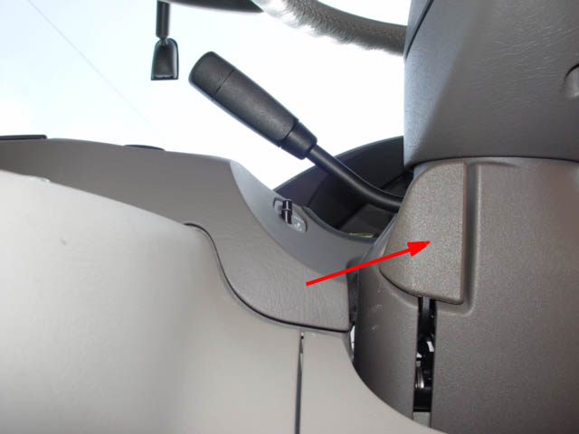
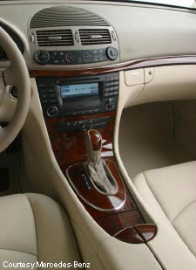
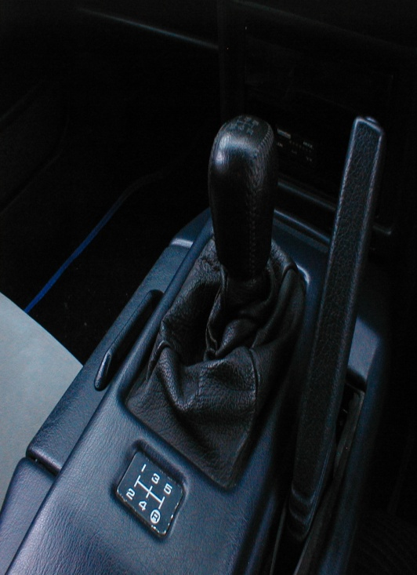
Vehicle Controls
Steering Wheel Adjustment
Tilts the steering wheel up or down.
Selector Lever
On the steering column or console.
*Gear Selector
Automatic or Stickshift

Slide 14
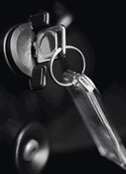
Vehicle Controls
Ignition and Starter Switch
Used to start vehicle
Cruise Control
Allows you to maintain your desired speed without keeping your foot on the accelerator. How do you cancel?

Slide 15
Vehicle Controls
Parking Brake
Helps to keep the vehicle in place when parked.
It could be a pedal or a brake-release lever.

Slide 16
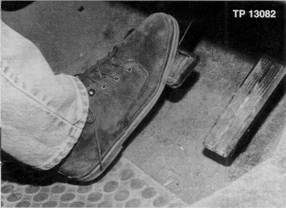
Vehicle Controls
Foot Brake
Slows or stops the vehicle.
Turns on brake lights in the back of the car.
Accelerator
Located to the right of the foot-brake, it increases and slows a vehicles speed.

Slide 17
More Devices
Head Restraints
Are padded devices on the backs of front seats.
They help reduce whiplash injuries.

Slide 18
More Devices
Inside and Outside Rearview Mirrors
The inside mirror should be adjusted so you can see completely out the rear window.
The left outside mirror shows a view to the left and rear .
The right outside mirror does the opposite.

Slide 19
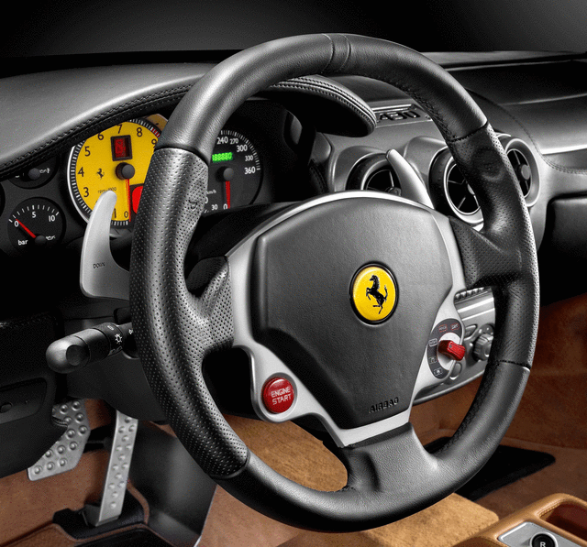
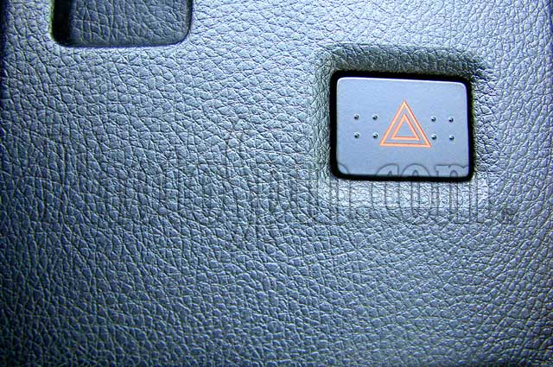
More Devices
Horn
Usually on the steering wheel and is used to communicate with other drivers and pedestrians.
Hazard Flashers
Usually located on the steering column or instrument panel.
These lights warn others that your vehicle is a hazard by flashing both front and back turn signals.

Slide 20
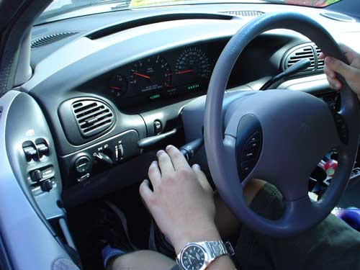
More Devices
Turn-Signal Lever
Located on the left side of the steering column.
Move it up to signal a right turn, down to signal a left turn.
Use it when turning, pulling out or changing lanes.
It’s The Law!

Slide 21
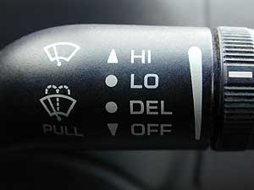
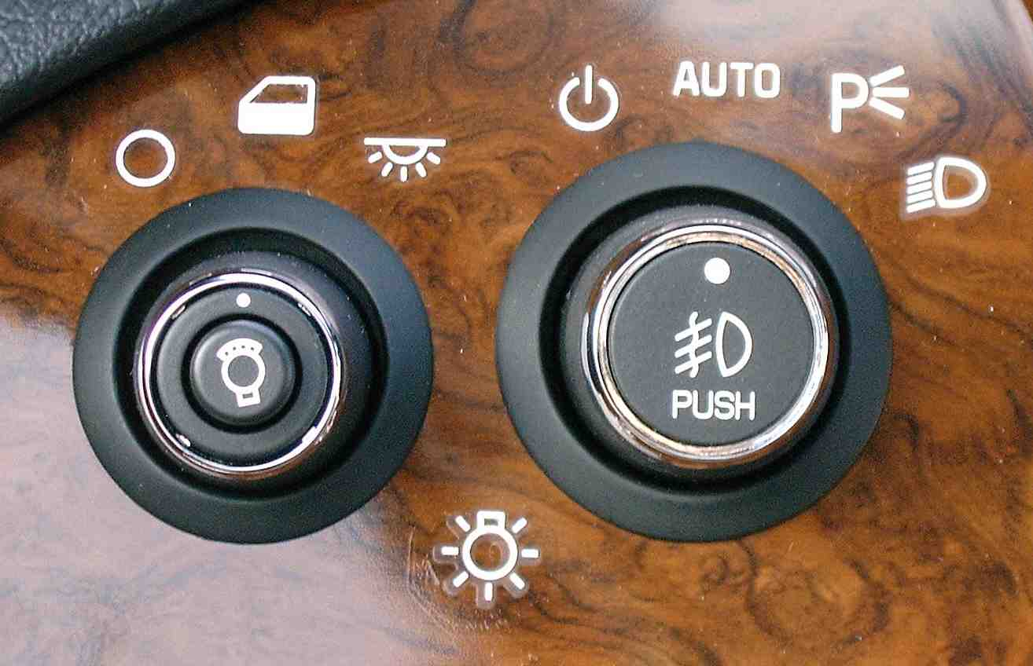
More Devices
Windshield Wipers and Washer
Used to clean the outside windshield it can often be found on the turn signal lever.
Light Switch
Controls headlights, taillights, parking lights, instrument panel, license plate, dome light and high beams.

Slide 22
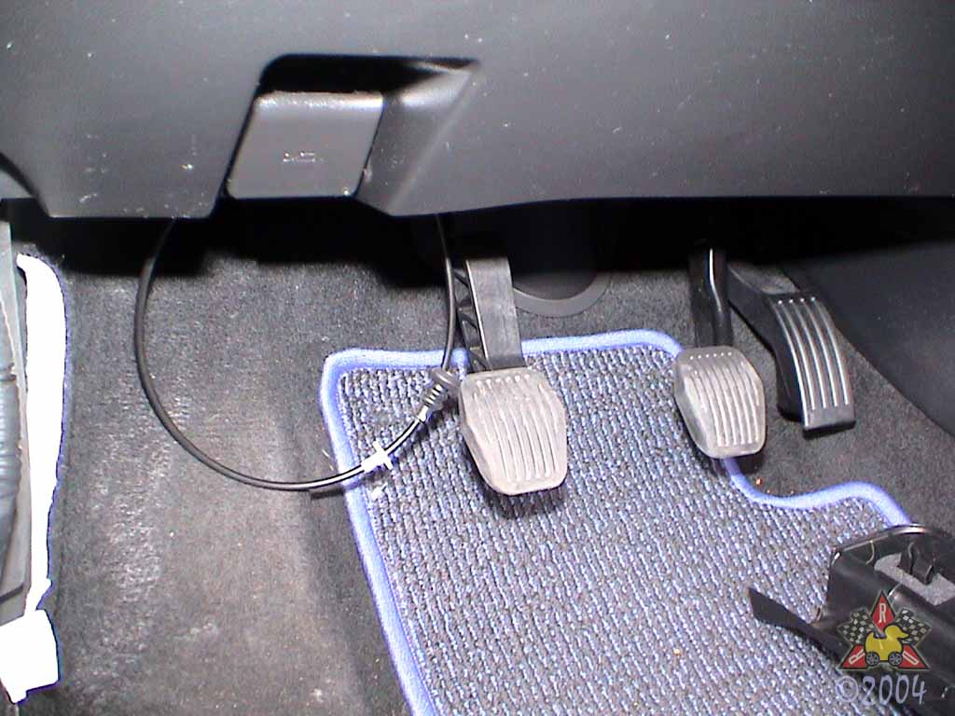
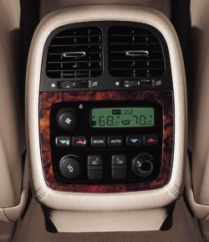
More Devices
Hood Release
Usually located on the left of the instrument panel or to the left of the driver’s seat.
Heater, Air Conditioner and Defroster
Control the temperature inside your vehicle and are usually located on the right side of the instrument panel.

Slide 23
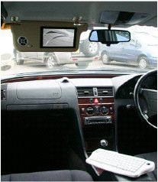
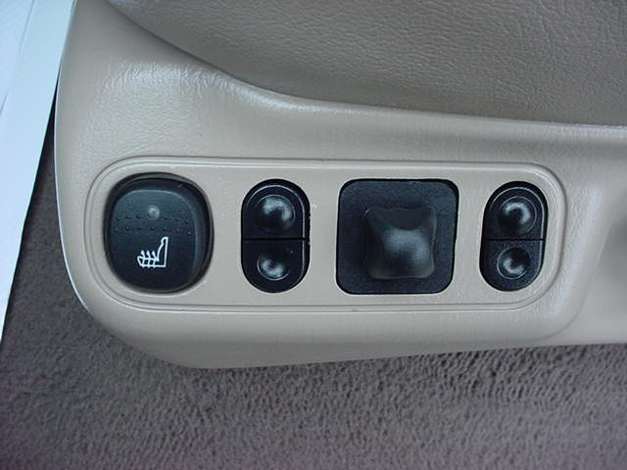
More Devices
Sun Visor
Are located above the windshield and help control sun glare.
Seat Adjustment Lever
Usually located at the lower front or left side of driver’s seat. *Could be lever in front.

Slide 24
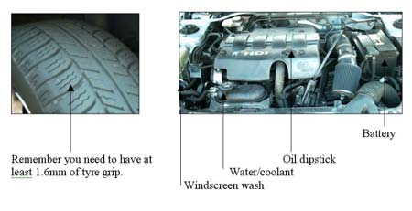
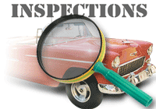
Getting Ready To Drive
Check outside:
Any Objects
Tires
When entering and exiting:
When entering on a street, walk around the front of the vehicle.
When exiting, walk to the rear.
*This makes sure that you can always see oncoming traffic.

Slide 25
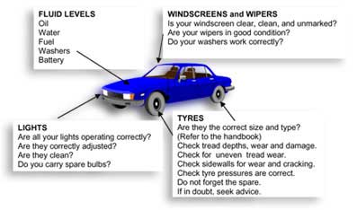
Preventative Maintenance Checks

Slide 26
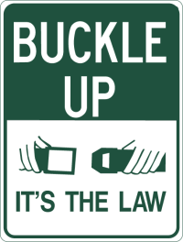
Getting Ready To Drive
Once inside, do your Pre-Drive Checks:
Lock All Doors
Place key into the ignition
Adjust your seat and steering wheel so you’re comfortable
Adjust your mirrors
Fasten Your Safety Belt!

