Slide 1
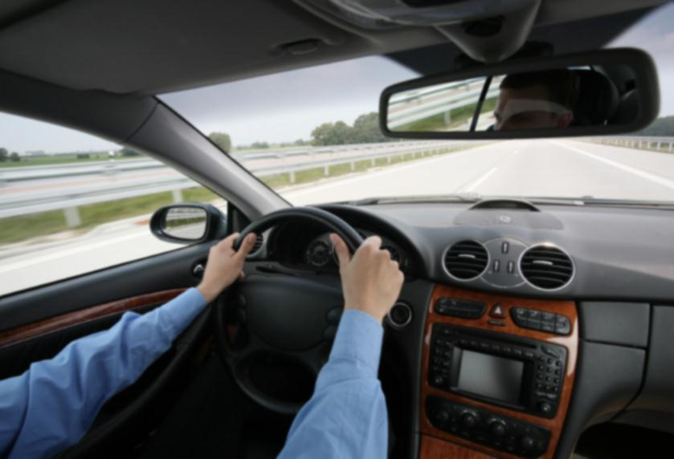
Chapter 1
You Are The Driver

Slide 2
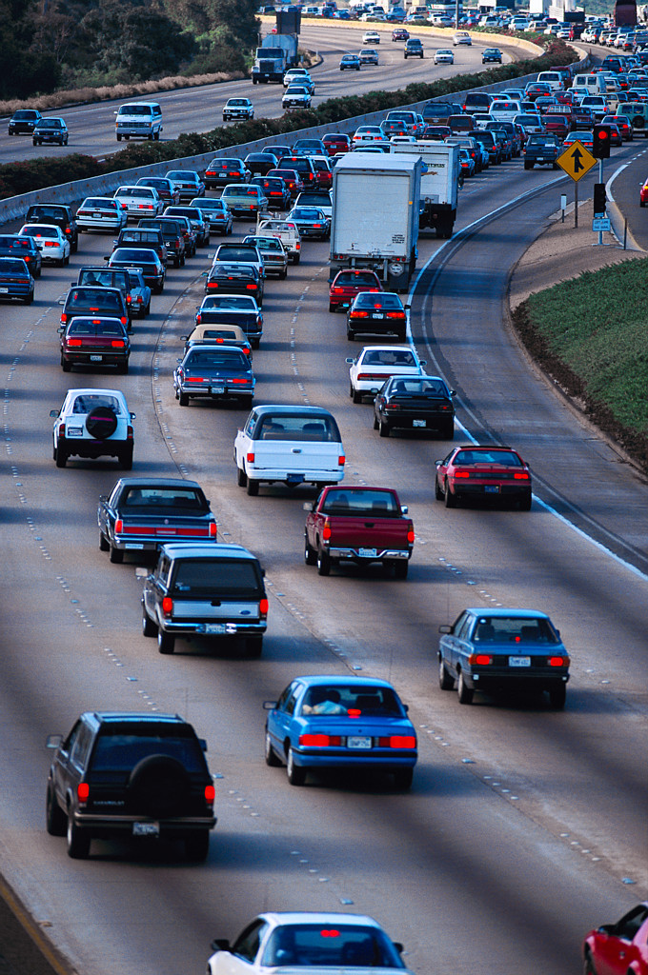
Highway Transportation System (HTS)
(HTS) is made up of three parts
Roadway users
People who us it. (walking, driving, or riding)
Vehicles
From mopeds to semi-trucks
Roadways
Paved roads, unpaved roads, or in hazardous conditions like rain, snow, or wind

Slide 3
Your Driving Task Skills
Mental
Critical judgments and continuous monitoring.
Social Skills
How you interact with other drivers.
Physical Skills
How you accelerate or brake.
Scan the rearview mirror.

Slide 4
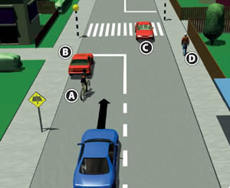
IPDE Process
Identify
The current driving situation
Predict
Points of conflict
Decide
When, where, and how to avoid conflict
Execute
The action you chose to avoid conflict

Slide 5
Using the IPDE process What would you do?

Slide 6
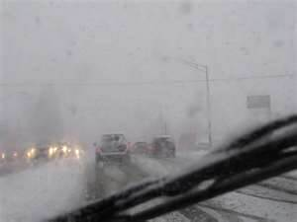
What about here

Slide 7
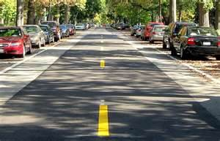
Last One

Slide 8
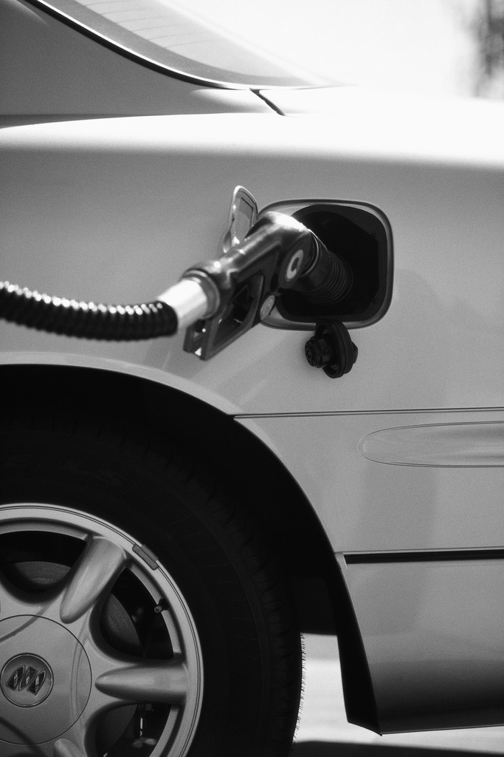
Your Driving Responsibilities
Legal Responsibilities
Laws and collisions
Financial Responsibilities
Operating costs
Fuel, oil, tires
Fixed costs
Car purchase, insurance, licensing fees
Crash costs
Costing nations billions of dollars
Missing work, Medical costs, property damage

Slide 9
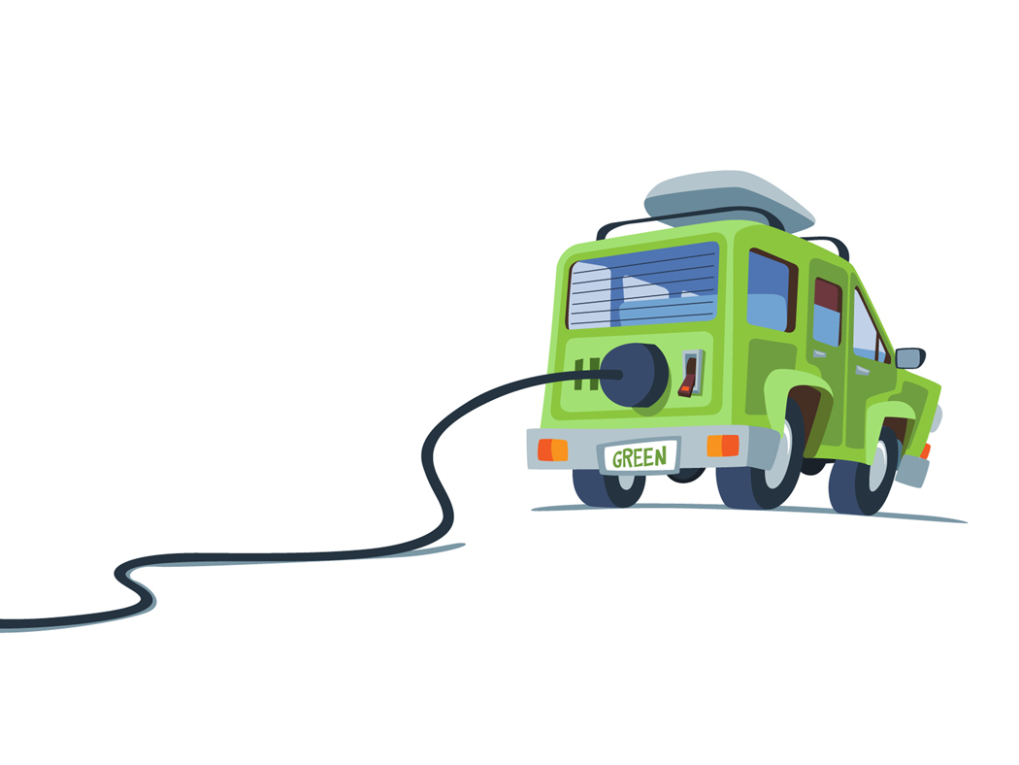
Your Driving Responsibilities (Cont.)
Environmental Responsibilities
Fuel efficient cars
Car pooling
Responsibility to yourself and others
Make rational decisions
Respect other drivers

Slide 10
Your Driver’s license
Graduate licensing phases
Learners permit stage
Receive permit to drive with adult
Permit must be held for nine months
Have to practice 50 hour (10 at night) with licensed driver 21 or older. (No Driving convictions)
Passengers one in front and how ever many seat belts in back.
No cell phones
Permit valid for two years

Slide 11
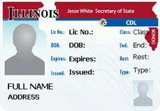
Your Driver’s license (Cont.)
Intermediate License stage
Complete learners permit stage, 50 hours and Driver Ed course
Night driving restrictions (Sun –Thur 10pm-6am-Fri-sat 11pm-6am)
Must be conviction free for six months prior to turning 18 before moving to full licensing phase
All occupants must were seatbelt and only one passenger under 20 unless they are related to you than as many as there are seatbelt. (for first 12 months or until 18)
No cell phones till 19 unless an emergency
Full Privilege License stage
No cell phones till 19 unless an emergency
No age restrictions apply except if driver fails to move stages

Slide 12
Your Driver’s license (Cont.)
Full Privilege License stage
No cell phones till 19 unless an emergency
No age restrictions apply except if driver fails to move stages

Slide 13
Review Questions Do in your notebook
What are the three parts of the HTS?
The driving task requires what three skills and give an example of each?
Name three financial responsibilities that drivers have to maintain?

