Slide 1
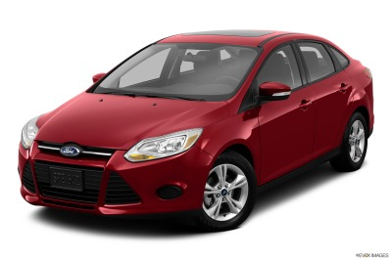
AUTO BUDGET PLAN

Slide 2
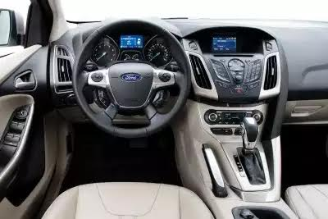

Slide 3
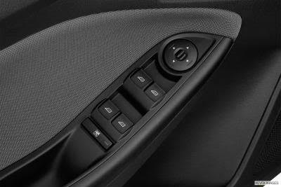
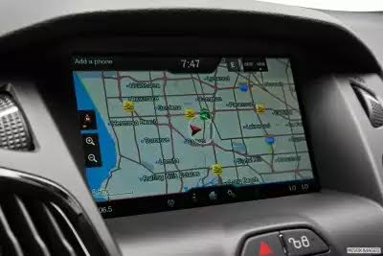

Slide 4
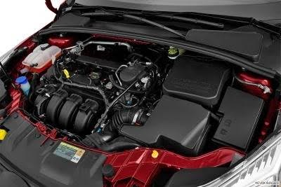

Slide 5
MOTOR VEHICLE CHOICE
MAKE: FORD____
MODEL: FOCUS__
YEAR: 2013______
MPG: CITY – 18_ HIGHWAY – 27_

Slide 6
VEHICLE PAYMENT PLAN
COST OF VEHICLE: $12,499.00
DOWN PAYMENT: $3000.00
AMOUNT FINANCED: $9,499.00
ANNUAL % RATE: 5.0%
INSTALLMENTS: 48
MONTHLY PAYMENT: $221.85

Slide 7
INSURANCE QUOTES
NAME OF INSURANCE CARRIER: SAFE AUTO
COVERAGE: COMPREHENSIVE X LIABILITY __
PAYMENT PLAN and AMOUNT
MONTHLY PAYMENT: $168.00
QUARTERLY$483.00
SEMI-ANNUAL: $1028.00

Slide 8
OTHER COSTS
FUEL COST/GALLON: $2.68 TANK CAPACITY: 15 GALLONS
FUEL COST TO FILL TANK: $40.20
MILES DRIVEN TO EMPTY TANK: 270 CITY 405 HIGHWAY
CHICAGO CITY VEHICLE STICKER: $87.00
ANNUAL VEHICLE PLATE RENEWAL: $101.00
OIL CHANGES: (EVERY 3 MONTHS OR 3000 MILES)
$29.99 X (4) = $119.96 YEAR
INCIDENTAL VEHICLE MAINTENANCE COSTS
WIPERS, AIR FILTERS, RADIATOR FLUSH/WINTERIZE,TIRES

Slide 9
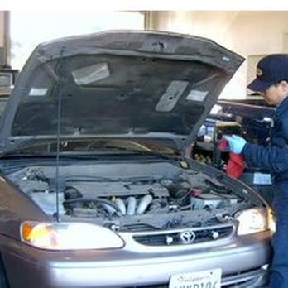

Slide 10
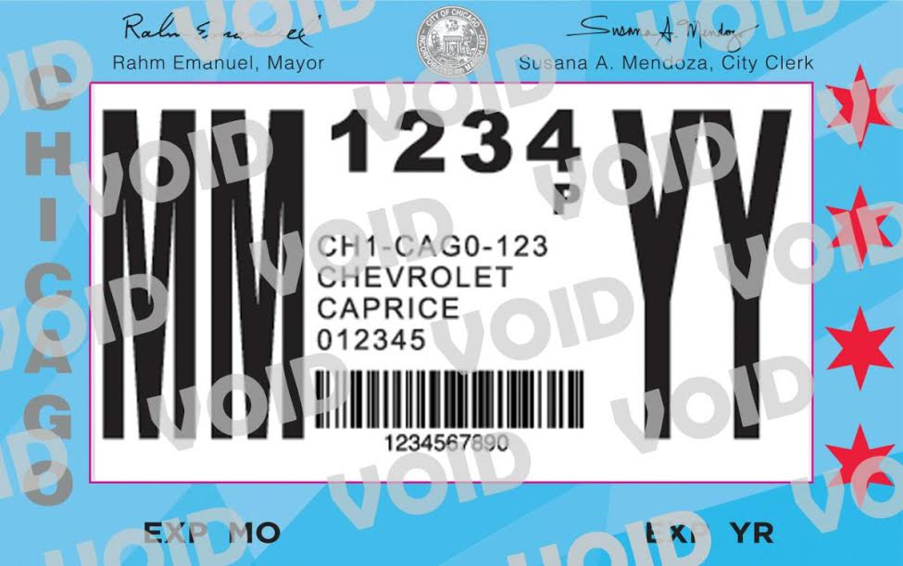

Slide 11
TOTAL ESTIMATED MONTHLY AUTO EXPENSES
MONTHLY CAR PAYMENT: $221.85
+MONTHLY INSURANCE: $168.00
+FUEL COST $80.40
+INCIDENTAL COSTS $30.00_______
$500.25/MONTH

Slide 12
CAN YOU AFFORD THIS MONTHLY PAYMENT??

